Slide 1
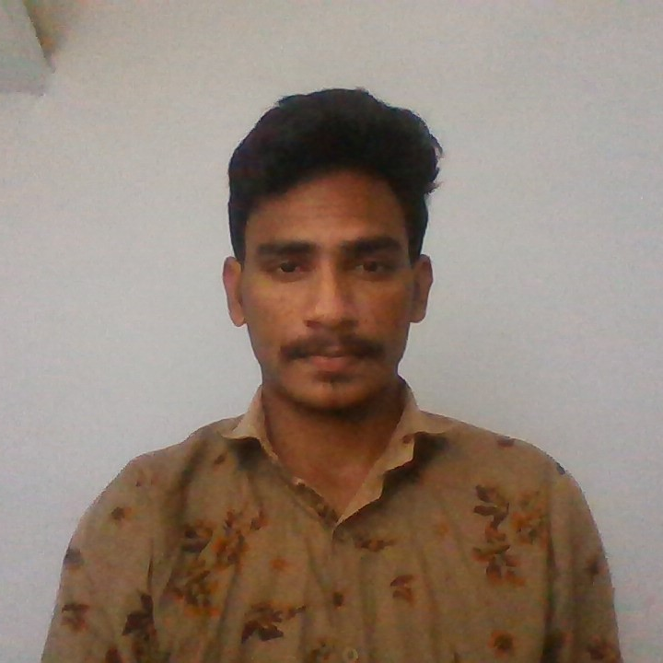



Durga sri ranga nadha gopi
Analyst/Software Engineer
Master of computer application: 2020 - 2022
Skills
Java 8 /J2EE | Java Basics, OOPS, Generics, Collections, Arrays, Loops, Stream API Junit, Mockito, Servlets
Spring core | IOC & Dependency Injection, Autowire
Spring REST | REST controllers, Implementation of GET, POST, PUT & DELETE, Bean Validation & Exception Handling, Testing Services, Controller & Repository layer
Spring Data JPA | Implement DAO layer using spring Data repositories, Transaction Management
Spring Boot Microservices | Spring Boot Starters, annotations, Messaging Service, Sync/Async comms, Swagger API documents
Spring Cloud | Eureka
React | Components, Hooks, Event handling, Redux, Reducers, Testing using Jasmin & Karma
Database | MongoDB My SQL
UI Tech | HTML 5 & CSS 3,JavaScript, ES6 & TypeScript Reusable templates, Optimized UI Designed
Tools | Git, Postman, Maven, IDE
Devops | CI/CD, Jenkins configuration, Build Pipelines, notifications, quality gate understanding
Add On skills | Communications, Team management. Peer learning
Bangalore
DURGA-SRI-RANGANADHAGOPI.SOMAROUTHU@CAPGEMINI.COM
91 7780196945
A4
Gopi somarouthu
Full Stack Developer
Hands on experience in creating microservices with Spring boot, Spring Security, Spring Cloud API Gateway, Eureka server, load balancing.
Proficient in creating Single page Web Application in React.
In Depth understanding of OOPs Concepts (core java)
Experience in creating spring boot application with testing using Junit, Mockito & Swagger.
Hands on experience in creating webpages using React, HTML, CSS & Bootstrap, JS & ES6 with good understanding of Document Object Model & DOM()
Filght booking system Application
Completed end to end case study of Flight booking system Application along with Swagger and payment testing using paytm pay, responsive UI with CSS & Bootstrap and React used for user interface.
Completed python Certification from Coursera.
Completed AWS cloud practitioner certification.
Completed GCP certification.

